Slide 1




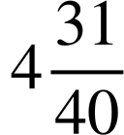

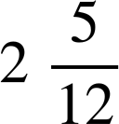
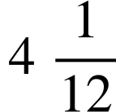


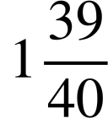

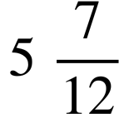





Securing understanding of addition and subtraction with fractions
Task A: Addition and subtraction involving mixed numbers
1) By calculating the value of each side complete the inequality statement by placing a < or > between them.
a)
b)
c)
>
<
>
2) Find the missing value in each diagram. Give your answer as a mixed number in its simplest form.
a)
?
b)
?
c)
?
d)
e)
f)
?
?
3) Find the missing digits:
a)
b)
c)

Slide 2



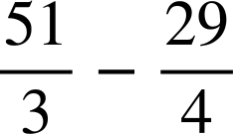
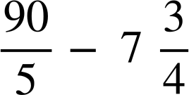
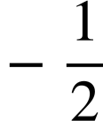
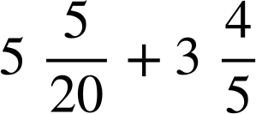
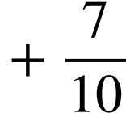
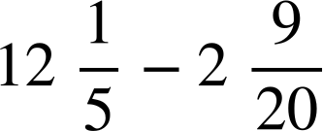

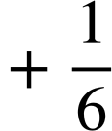
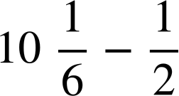
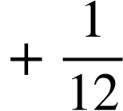

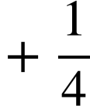
Securing understanding of addition and subtraction with fractions
Task B: Efficient calculation strategies
1) Which of these are equal to ?
a)
d)
g)
b)
e)
h)
i)
For those that do not have an answer of , what do you need to add or subtract so that they do?
c)
f)
Mathematics in Education and Industry
v2.2

